Slide 1

RUNGTA COLLEGE OF DENTAL SCIENCES AND RESEARCH
TARNISH AND CORROSION
DEPARTMENT OF CONSERVATIVE DENTISTRY AND ENDODONTICS

Slide 2
Specific learning Objectives
Core areas* | Domain ** | Category #
Introduction | Cognitive | Must know
Tarnish | Cognitive | Must know
Corrosion | Cognitive | Must know

Slide 3
CONTENTS
Introduction
Tarnish
Corrosion
Effect on individual metals
Management
Conclusion
References

Slide 4
OBJECTIVES
To define tarnish and corrosion
To understand the mechanism of tarnish and corrosion
To classify various types of corrosion
To undertake methods to prevent tarnish and corrosion

Slide 5
INTRODUCTION
Tarnish :- Discoloration of surface of a metallic appliance or restoration due to chemical action.
- leads to loss of surface gloss, luster &
finish.
Corrosion :- In the specific sense is not merely a surface deposit but is an actual deterioration of a metal by reaction with its environment.
- continuation of tarnish.

Slide 6
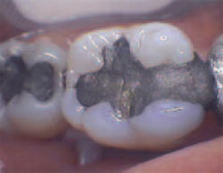
TARNISH
Definition:- Process by which a metal
surface is dulled or discolored when
a reaction with a sulfide, oxide ,chloride or other
chemical causes a thin film to form. (Skinners)
Tarnish is a forerunner of corrosion.
The film producing tarnish may accumulate on elements or
compounds that chemically attack the metal surface.
eg: - eggs and food containing sulfur.
- water, oxygen and chlorine ions in saliva contribute to
corrosion attack.

Slide 7
CAUSES OF TARNISH
Tarnish in oral environment occurs from the formation of hard and soft deposits on the surface of the restoration.
Calculus is the principal hard deposit.
Soft deposits are plaque, mucin and films mainly
composed of microorganisms.
Stains or discoloration arising from pigment producing bacteria, drugs containing chemicals ( iron and mercury).
Adsorbed food debris and formation of thin films such as oxides, sulfides and chlorides.

Slide 8
Effects:-
- surface gloss, finish & luster decreases.
- color parameters change.
- if tarnish continues it results in corrosion
or loss of surface material.

Slide 9
METHODS FOR DETECTION
Visual method
Densitometers → measuring the amount of light reflected or scattered with respect to time. A densitometer is a device that measures the degree of darkness (the optical density) of a photographic or semitransparent material or of a reflecting surface.

Slide 10

CORROSION
Definition: Chemical or
electrochemical process in which a
solid, usually a metal is attacked by
an environmental agent, resulting in partial or
complete dissolution. (Skinners)
Physiochemical interaction between the metal & its environment form metallic compounds.
It’s the continuation of tarnish with loss of surface metal and causes severe catastrophic disintegration of metal body.
Eg. Rusting of iron or carbon steel which makes it brittle.

Slide 11
CAUSES OF CORROSION
Action of moisture, atmosphere, acid or alkaline solutions.
The film that is deposited and produces tarnish from elements or compounds that chemically attack metallic surface.
Ex: 1) Foods containing sulfur such as eggs. Hydrogen and ammonium sulfides corrode silver, copper and mercury in dental alloys and amalgam.
2) Water, oxygen and chlorine in saliva cause corrosion.
3) Phosphoric acid, lactic acid and acetic acid at proper
concentration can cause corrosion.

Slide 12
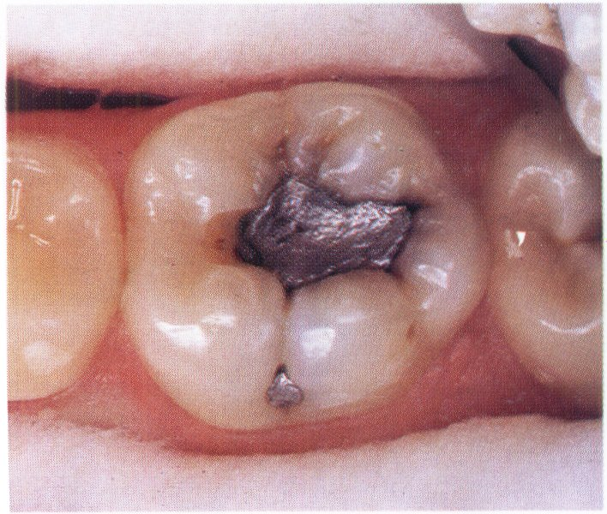
EFFECTS OF CORROSION
Loss and degradation of metal structure affecting the physical and mechanical properties.
Formation of rough surface leading to further corrosion.
Loss of surface finish results in poor esthetics.

Slide 13
Classification
-Occurs without any presence of - It requires the presence of water or water or fluid electrolyte or some fluid electrolyte
Corrosion
Dry or Chemical corrosion
Wet or Electrochemical corrosion

Slide 14
CHEMICAL CORROSION
Direct combination of metallic & non metallic elements to form a chemical compound through a process such as oxidation, halogenation or sulfurization reaction. Eg. Discoloration of silver by sulfur where silver sulfide forms by chemical corrosion.
Thin films are formed on surface of metals due to these reaction which get easily dissolved or detached in solutions leading to loss of material from surface.
Also called as dry corrosion since it occurs in absence of water or other fluid electrolytes.

Slide 15
ELECTROCHEMICAL OR WET
CORROSION
Also called as wet corrosion as it refers to loss of materials from surface of a solid due to chemical reactions in wet conditions i.e. in presence of a electrolytic solution such as saliva, water or ionic solutions.
Accompanied by loss of ions or atoms of a solid usually metal due to passage of electric charges through an electrolyte.

Slide 16
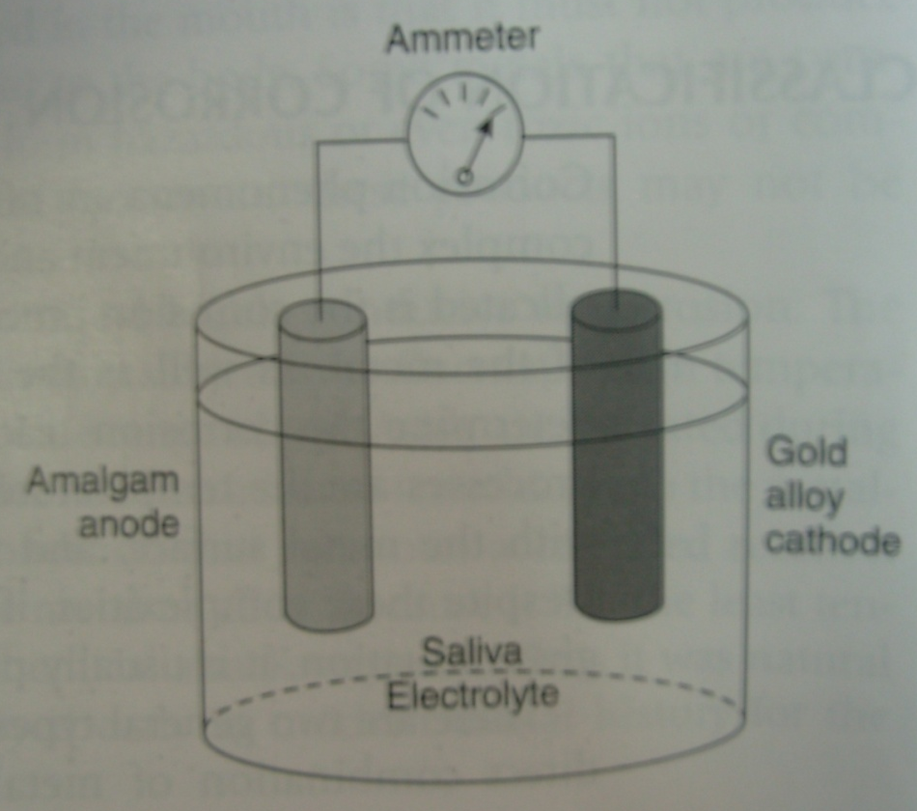
ELECTRO-CHEMICAL CELL
2 electrochemically dissimilar metals
Immersed in an electrolyte and connected by an electrical conductor
Electric couple
CORROSION
Galvanic current
Corrosion

Slide 17
COMPONENTS OF CELL
CELL ORAL CAVITY
ANODE AMALGAM RESTORATION
CATHODE GOLD INLAY
ELECTROLYTE SALIVA
EXTERNAL CIRCUIT HARD & SOFT TISSUES

Slide 18
Anode: →
Surface or sites on surface where positive ions are formed.
(ie metal surface undergoing oxidation reaction and
corroding with production of free electrons)
Cathode:→
At the cathode reduction reaction occurs that consumes free electrons produced at the anode.

Slide 19
REACTIONS
ANODE (amalgam) – OXIDATION
Mº M⁺ + e⁻
Corroding metal surface; + ions formed ; (e⁻) produced .
CATHODE (gold) – REDUCTION
M⁺ + e⁻ Mº
2H⁺ + 2e⁻ H₂
2H₂O + O₂ + 4e⁻ 4(OH)⁻
Site for consumption of (e⁻) produced at anode
for maintaining balance & continuing corrosion.

Slide 20
The electrolyte supplies ions needed at the cathode and carries away the corrosion products at the anode.
External circuit – Hard & soft tissues
Conduction of (e-)
Anode Cathode
(production of e⁻) (consumption of e⁻)
→ are primary driving force in
electrochemical corrosion.
Important in determining Important to reduce or eliminate
the rate of corrosion corrosion
Cathodic reactions

Slide 21
For electrochemical corrosion to be an ongoing process there should be balance between production of e⁻ at the anode and consumption of e⁻ at the cathode.

Slide 22
ELECTRO-MOTIVE FORCE
SERIES
An arrangement of elements in the order of their dissolution tendencies in water.
Potential value(v) for each element is calculated for standard state consisting of 1atomic weight (g) of ions in 1000 ml water at 25°c.
Metals with more positive potential have a lower tendency to dissolve in aqueous environments.

Slide 23
If 2 pure metals are immersed in an electrolyte and connected by a conductor to form a galvanic cell, the metal with lower electrode potential becomes anode and undergoes oxidation ie its ions goes into the solution.
for eg:
In a cell composed of cu and zn electrodes in aqueous acidic solution
zn electrode -0.76 v → Acts as anode
cu electrode -0.47v
EMF series provides information only about whether given reaction can occur or not.
It does not predict → the occurrence of corrosion.
→ the rate of corrosion.

Slide 24
METAL ELEC. POT. (V)
Gold + 1.36
Palladium + 0.82
Mercury & Silver + 0.80
Copper + 0.47
Hydrogen (Ref.) 0.00
Lead - 0.12
Tin - 0.14
Nickel - 0.23
Chromium - 0.56
Zinc - 0.76
Aluminium - 1.70

Slide 25
CLASSIFICATION OF ELECTROCHEMICAL
CORROSION
Galvanic corrosion.
Heterogeneous surface composition corrosion.
Stress corrosion.
Concentration cell corrosion.
Microbiological corrosion.

Slide 26
GALVANIC CORROSION
This type of corrosion occurs when two dissimilar metals or alloy restorations come in contact in presence of electrolytes or separated in presence in ionic medium like saliva, dentinal fluids, blood etc.
A potential difference develops between the two, this drives an electric current through tissue fluids, dentinal fluids & pulp completing a circuit & causing pain.

Slide 27
GALVANIC SHOCK
A pain sensation caused by electric current generated by a contact between 2 dissimilar metals, forming a battery in the oral environment.
A galvanic current is generated due to difference in electromotive potential existing in oral cavity when an electric couple is formed due to –
# 2 electrochemically dissimilar restorations
(E.M.P difference of restorations)
# Single, isolated metallic restoration
(E.M.P difference of electrolytes)

Slide 28
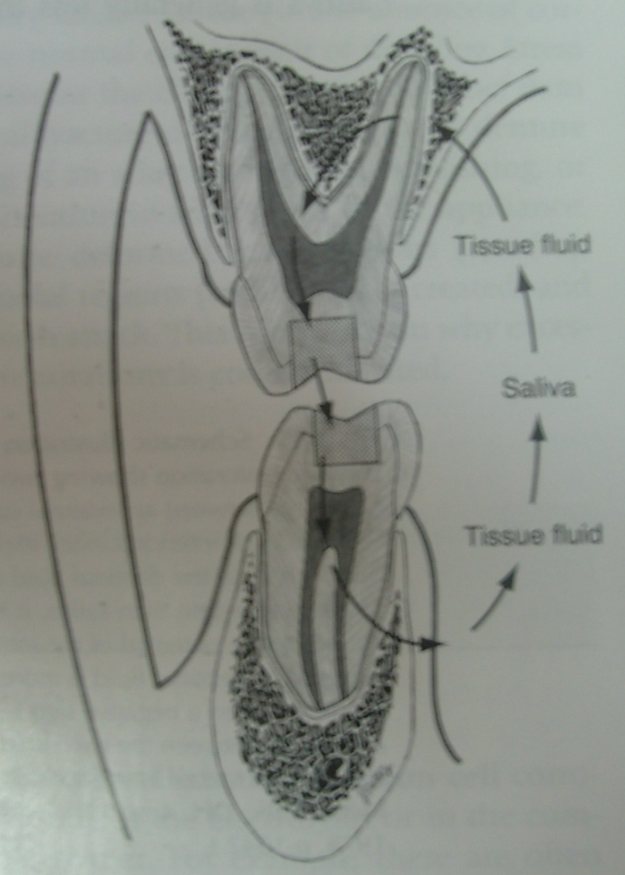
2 ELECTROCHEMICALLY DISSIMILAR
RESTORATIONS
Contact of
Restorations
AMALGAM RESTORATION
Electric
couple
Saliva
Short circuit
of potential
Pain sensation
GOLD INLAY

Slide 29
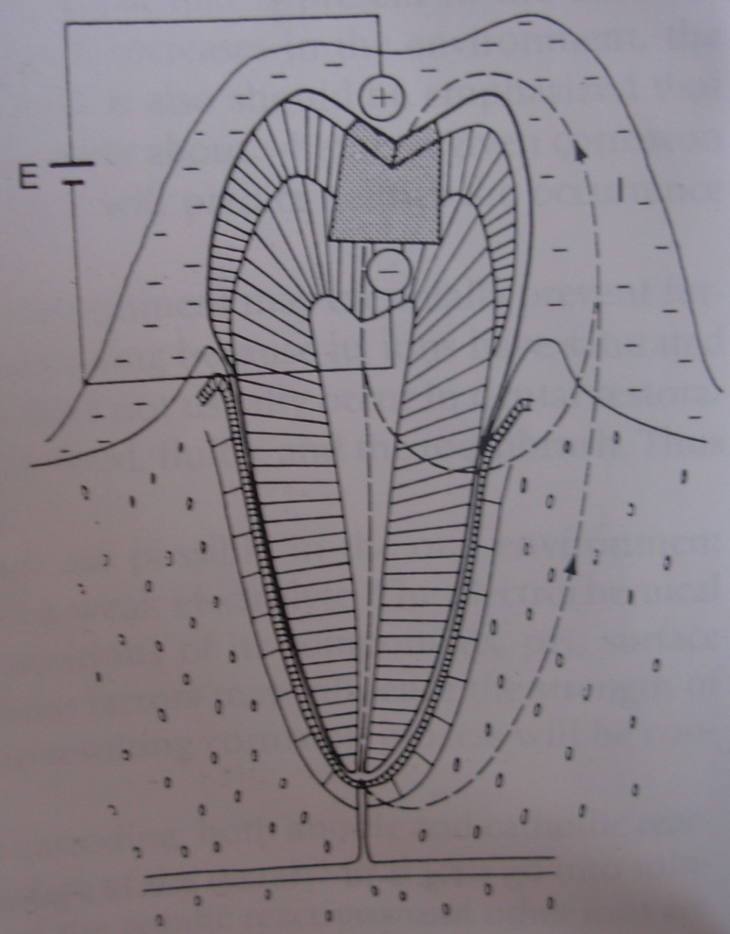
A single metallic restoration
External surface
exposed to saliva
+
Internal surface
exposed to
tissue fluids
-
Current
I
Potential difference
between 2 surfaces
E

Slide 30
REMEDY
Avoid Dissimilar Metals in opposing
arches.
Provide Insulating Bases underneath the
restoration.

Slide 31
Take home message
Tarnish & Corrosion are obviously undesirable, as it can spoil the aesthetics of an alloy, and also can weaken the material.
Hence the very important requirement of any metal or the alloy that is to be used in the mouth is that it should not produce corrosion products that will be harmful to the structure.
In addition to choosing the best materials, alloy must be used correctly, and situations which are likely to lead to corrosion must be avoided as far as possible.

Slide 32
QUESTIONS
Define tarnish and corrosion
Classify corrosion
Types of electrochemical/wet corrosion
Explain galvanic corrosion and methods to prevent the same
Methods to prevent tarnish and corrosion

Slide 33
REFERENCES
Science Of Dental Materials -----9th Edition By Skinners.
Art And Science Of Operative Dentistry -4th Edition-Studervant
Operative Dentistry 2nd Edition By Summit, Robbins ,Schwarts .
Restorative Dentals Materials 11th Edition By Craig.
Packard’s Manual Of Operative Dentistry 8th Edition E.A.M.Kidd, G.N. Smith, T.N.Watson.
Operative Dentistry Edition, By Marzouk .

